Slide 1
How to chunk big goals down into attainable steps?

Slide 2
Contemplating the enormous distance between where you stand now and where you want to get to can be intimidating and demoralising

Slide 3
What is chunking?
It´s the secret to make your goals come to life by breaking your big goal down into lots of smaller steps
that will gradually get you to where you want to be

Slide 4
By creating a series of realistic mini goals along the way, you can feel a constant and building sense of achievement, encouraging you to work even harder.

Slide 5
How do you start?
To start chunking you need to work backwards from your end goal: each time you identify a smaller goal, see if that can be broken down into more mini goals.
Mini-goal smaller goal end goal

Slide 6
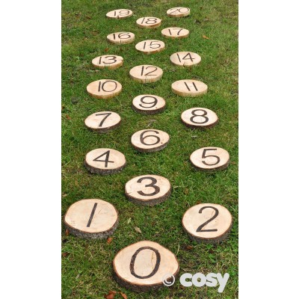
Build a timeline of your tasks
Start putting your tasks in chronological order, working out what needs to happen for another task to begin.
Each step should be something that is comfortably do-able, and helps you to see your ambitious end goal in a more achievable light.

Slide 7
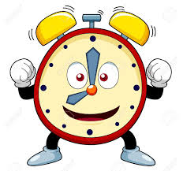
Decide when you want to reach your goal
Now you can work out how much time you have for each step. Some may take more time than others, so make sure you allocate enough time for each.

Slide 8
Work out what you need to achieve each step
Think about what practical things, knowledge or professional assistance you will need

Slide 9
Keep your eyes on the next step – not the top of the mountain
The real power of chunking is keeping your mind confidently on what you know you can do, and preventing you from being intimidated by what you want to get.

